Slide 1
Introduction to NVivo Part 4: Visualisations with NVivo
Alex Shermon | Research Computing Services

Slide 2

Welcome to Research Computing Services!

Slide 3
Digital Support Packs
During this time, we’ve moved our face to face training online.
Our trainings are now shorter, and are accompanied with an online learning lab.
This lab will help guide you through today’s training, and contains extra resources to help you learn NVivo!

Slide 4
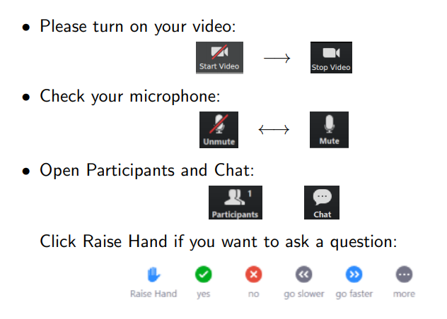
Zoom Etiquette

Slide 5
About Me
Masters of Global Media Communications Student
Omeka and NVivo Research Community Coordinator
Research Assistant on some neat archival projects
Playing SO MUCH Dungeons and Dragons right now

Slide 6
Today’s Learning Objectives
This workshop will teach you how to create visualisations from your data in NVivo
By the end of this workshop you will understand how to:
Create a Word Cloud and Cross-Table using Queries
Create a Bar Chart
Create a Hierarchy Chart

Slide 7
Queries

Slide 8
The State of our Research Project
In Parts 1, 2, and 3 I imported, coded, and reflected on my data which was aimed at answering the research project: what do these interviewees have to say about the water system in their local area and does this differ across demographic attributes?
Today, now that I’ve done the hard yards, I want to begin to visualise my data to gain a better understanding of what my research is telling me. To do that, I’ll be creating word clouds, cross tables, bar charts, and hierarchy charts!

Slide 9
What are Queries?
Queries are designed to help you to “explore” your data in NVivo/
Queries can be used to:
Search through text in your project
Find combinations of items
Calculate word frequency

Slide 10
For our Research Project
The first thing I want to do is to just quickly check the prominence of key words and phrases in my research project.
To do that, I’ll whip up a quick word cloud, before creating a cross-table to help me to start comparing themes and demographic attributes.
This wouldn’t be possible if I hadn’t spent many afternoons working away at my codes and cases!

Slide 11
Demo: Creating a Word Cloud
In this demo, I’ll show you how to create and edit a Word Cloud using the queries function on NVivo

Slide 12
Challenge 1: Create and Edit a Word Cloud
Using the queries function, create a word cloud
Extension tasks
Attempt to change the colour and presentation of the word cloud
Attempt to remove words from the word cloud

Slide 13
Demo: Cross Tables
In this demo, I’ll show you how to create a cross table
This is also referred to as “Matrix Coding”

Slide 14
2. Bar Charts

Slide 15
Bar Charts in NVivo
If you’re anything like me, you might be frustrated with how bar charts are designed and presented in NVivo.
Broadly, it’s good to make sure that you have a robust set of codes, cases, and files to play around with bar charts.
On the Mac, make sure that you have a file or node selected so that the bar chart option is not blurred out for you.

Slide 16
For our Research Project
Having created a lovely cross-table, I want to see if there are more impactful ways to present some of my research findings.
In particular, I want to see how some coding looks in a single file, to do that, I’ll be creating a bar graph!

Slide 17
Demo: Creating a Bar Chart in NVivo
In this demo, I’ll show you how to create a bar chart in NVivo

Slide 18
Challenge 3: Creating a Bar Chart in NVivo
Create and edit a bar chart
Attempt to edit the chart
It’s important to think about what kinds of questions you might be able to answer using this type of visualisation.

Slide 19
3. Hierarchy Charts

Slide 20
What are Hierarchy Charts?
Hierarchy Charts are a great way to get a snapshot of your data and to help kickstart the process of writing (from my own experience)
Having a hierarchy chart open while you write a memo, annotation, or in your research is a really smooth workflow.
They’re also a great way of showing the proportion of coding across your project, so you can see the most prominent themes.

Slide 21
For our Research Project
Now that I have some insightful visualisations created, I am thinking about beginning to write up my results, analysis, discussion etc.
However, none of the visualisations I’ve created thus far are going to give me a broad perspective on my research data.
For that, I will turn to a hierarchy chart to provide me with the data I need to begin writing!

Slide 22
Demo: Creating a Hierarchy Chart
In this demo, I’ll show you how to create a hierarchy chart!

Slide 23
Challenge 4: Creating a Hierarchy Chart
You guessed it!
Using your powerful knowledge and expertise of NVivo, create a hierarchy chart and explore it!

Slide 24
Wrapping up
This workshop has hopefully introduced you to ways to visualise your research data in NVivo
This concludes the basic four part course on how to use NVivo. Part 5 is about literature reviews, and Part 6 concerns using Twitter data and web scraping with NVivo.
Today, you should know how to
Use queries to create word cloud and cross-tables
Create a bar graph
Create a hierarchy chart

Slide 25
Next Steps
As always, the GitBook contains extra videos and information to help you learn NVivo: http://go.unimelb.edu.au/2i3r (Module 5 on Lit Reviews is now up!) - I’m currently putting together the one from the training today!
Please fill in the feedback form:
Join the Facebook group if you have any questions: https://www.facebook.com/groups/unimelbnvivo
Get in touch with me at alex.shermon@unimelb.edu.au

